Slide 1

DST-CIMS M.Sc. STATISTICS AND COMPUTING SEM-IV PROJECT PRESENTATION guided by Dr. Dinesh Kumar
DHIRAJ KUMAR
ROLL NO. :20419STC010
ENROLLMENT NO :430372

Slide 2


Slide 3

Sharing Bike has come a new concept now a days where one doesn’t have to buy a bike to enjoy their daily ride. Currently It has introduced in so many urban countries for enhancement of mobility comfort. One can rent bikes on several basis like hourly, daily, monthly etc. It has a significant role to the rising issues related to the global warming, climate change, carbon emission and many more environmental anomalies. It is very important to make rental bikes available and accessible to the customers to the right time as it lessens the waiting time

Slide 4
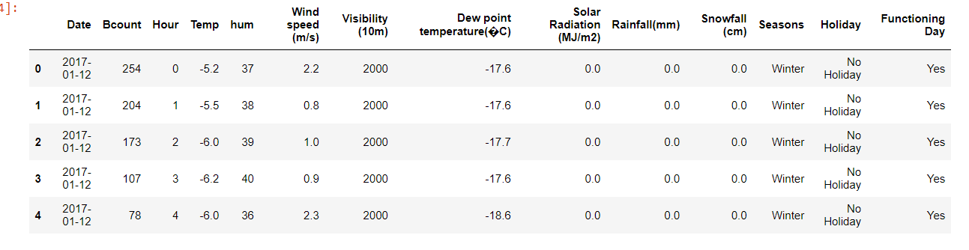
Attribute Information: Date : year-month-day Rented Bike count - Count of bikes rented at each hour Hour - Hour of the day Temperature-Temperature in Celsius Humidity - % Wind speed - m/s Visibility - 10m Dew point temperature - Celsius Solar radiation - MJ/m2 Rainfall - mm Snowfall - cm Seasons - Winter, Spring, Summer, Autumn Holiday - Holiday/No holiday Functional Day - NoFunc(Non Functional Hours), Fun(Functional hours)
Dataset Information

Slide 5
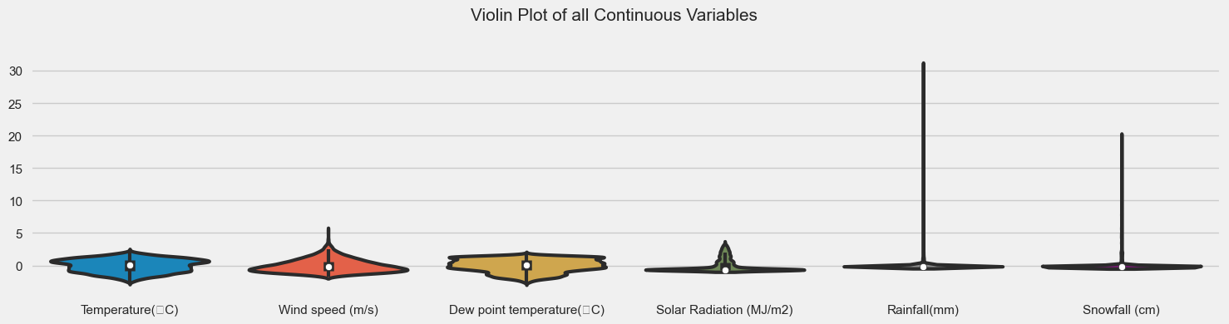
Exploratory Data Analysis

Slide 6
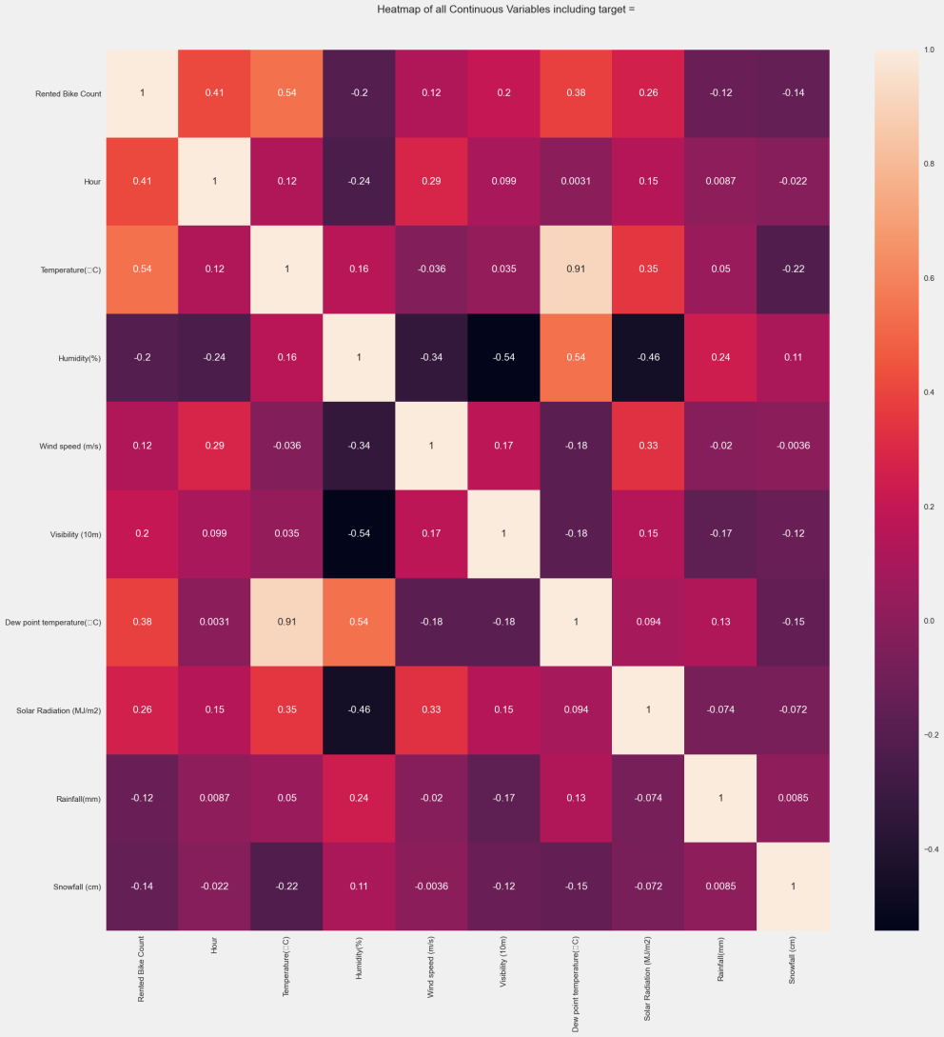
Scatter Plot

Slide 7
Insights of our Data Visualizations
Rented Bike Count (Dependent Variable) and wind speed (Independent Variable) are Positive skewed and their skewness are 1.15 and 0.89.
There are many outliers present in Rainfall and Snowfall.
The data points of temperature and Dew point temperature are nearly symmetrical.
Rental Bike Count (Dependent Variable) is highly correlated with Temperature (Independent Variable).
Temperature (Independent Variable) is highly correlated with Dew point Temperature (Independent variable).
Solar Radiation has 4300 (49.1%) zero values
Rainfall has 8232 (94.0%) zero values
Snowfall has 8317 (94.9%) zero values
The categories in Seasons attribute (summer, Spring, Autumn, Winter) are equally distributed in our dataset.

Slide 8
Data Preprocessing
Data Cleaning
Missing Values
There are 14 attributes in our dataset and there is no any missing value in any of the attributes.
Data Transformation
One Hot Encoding : a one-hot is a group of bits among which the legal combinations of values are only those with a single high (1) bit and all the others low (0).
We have considered four categorical attributes for one hot encoding and these variables are Hour,Seasons,Holiday,Functioning Day

Slide 9
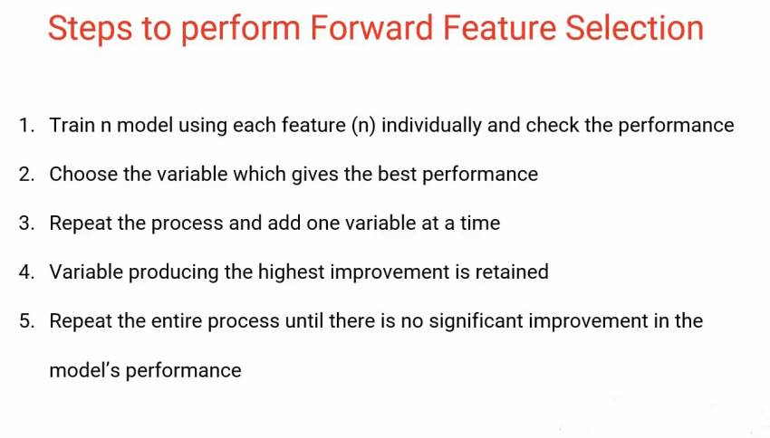
Feature Selection
Forward Feature Selection is to train n models using each feature individually and checking the performance. So if you have three independent variables, we will train three models using each of these three features individually .

Slide 10
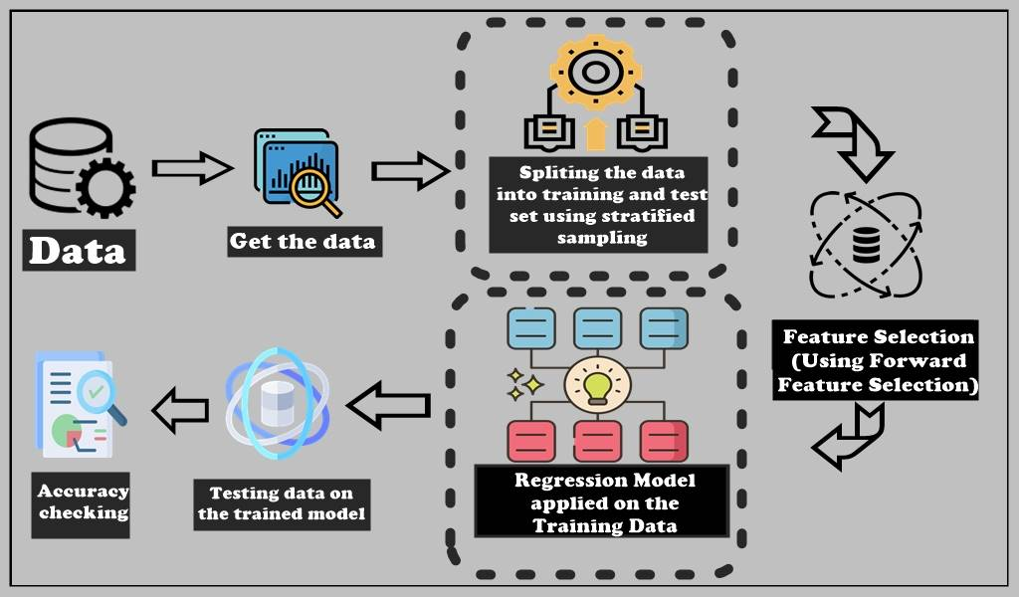
Model Selection

Slide 11
Multiple Linear Regression
Multiple linear regression (MLR), also known simply as multiple regression, is a statistical technique that uses several explanatory variables to predict the outcome of a response variable. The goal of multiple linear regression is to model the linear relationship between the explanatory (independent) variables and response (dependent) variables. In essence, multiple regression is the extension of ordinary least-squares (OLS) regression because it involves more than one explanatory variable.
Y_{i}​ = β₀​ + β_{1​}x_{i1}​ + β₂​x_{i2}​ +...+ β_{p​}x_{ip}​ + ϵ

Slide 12
Model Description
OLS Regression Results
Dep. Variable: | y | R-squared (uncentered): | 0.809
Model: | OLS | Adj. R-squared (uncentered): | 0.808
Method: | Least Squares | F-statistic: | 770.6
Date: | Thu, 28 Apr 2022 | Prob (F-statistic): | 0.00
Time: | 11:31:16 | Log-Likelihood: | -3877.7
No. Observations: | 6570 | AIC: | 7827.
Df Residuals: | 6534 | BIC: | 8072.
Df Model: | 36
Covariance Type: | nonrobust

Slide 13

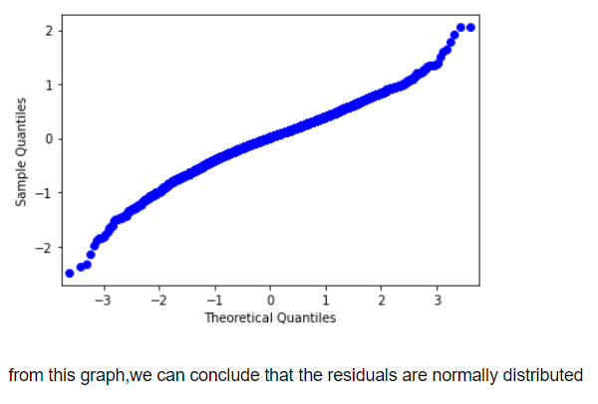
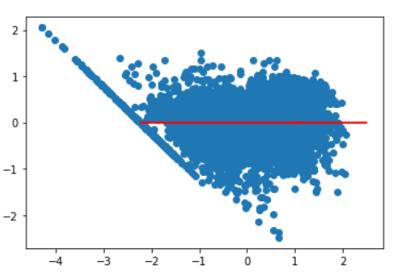
Assumptions of linear regression
Mean of Residuals
Checking for normality of the residuals Checking for homoscedasticity

Slide 14
Conclusion
From the above results we can see that the R² score for Multiple Linear Regression model is 0.808 which means our model is able to explain 80.8% of the variability in the dataset.

Slide 15

The End

